Slide 1
DATA ANALYTICS PORTFOLIO PROJECT
Bank Loan Analysis
Turning 39,717 loan records into portfolio insight — from raw SQL queries to executive-ready dashboards
SQL
EXCEL
TABLEAU
POWER BI
2007 – 2011 Loan Portfolio | September 2026

Slide 2
OVERVIEW
Agenda
Project Overview
Excel Dashboard
01
02
Objective, scope and analytics workflow
KPI reporting with interactive slicers
SQL Queries
Tableau Dashboard
03
04
The logic layer behind every KPI
Deep-dive visual exploration
Power BI Dashboard
Findings & Recommendations
05
06
Executive business-intelligence view
What the portfolio is telling us
BANK LOAN ANALYSIS
2

Slide 3
PROJECT OVERVIEW
Objective & Scope
The Goal
39,717
Analyze five years of bank lending activity to understand how the loan portfolio grew, who the borrowers are, and where risk is concentrated — then present those findings through four complementary analytics tools.
Customers Analyzed
What We Set Out to Answer
$445.6M
How has loan origination volume evolved between 2007 and 2011?
What borrower risk signals matter most — DTI, interest rate, verification status?
Which loan purposes and home-ownership types drive the portfolio?
How consistently do Excel, Tableau, SQL and Power BI tell the same story?
Total Loan Amount
2007–2011
Portfolio Time Span
PROJECT OVERVIEW
3

Slide 4
PROJECT OVERVIEW
Dataset & Tools
The Dataset
S
SQL
Cleans data and calculates every KPI from first principles
Loan-level records for 39,717 customers, issued 2007–2011
Loan amount, interest rate, grade & sub-grade, DTI
Verification status: Verified, Source Verified, Not Verified
Home ownership, loan purpose, revolving balance
State, last payment date and loan status (Current / Fully Paid / Charged Off)
E
Excel
Interactive KPI dashboard with slicers for fast filtering
T
Tableau
Rich, drillable visual exploration of trends
P
Power BI
Executive-ready business intelligence reporting
PROJECT OVERVIEW
4

Slide 5
PROJECT OVERVIEW
Analytics Workflow
One dataset, validated once in SQL, delivered through three reporting layers.
1
2
3
4
→
→
→
Data Cleaning & SQL Analysis
Excel Dashboard
Tableau Dashboard
Power BI Dashboard
Aggregate KPIs and validate logic
Fast, slicer-driven KPI reporting
Visual, drillable trend analysis
Executive business-intelligence view
PROJECT OVERVIEW
5

Slide 6
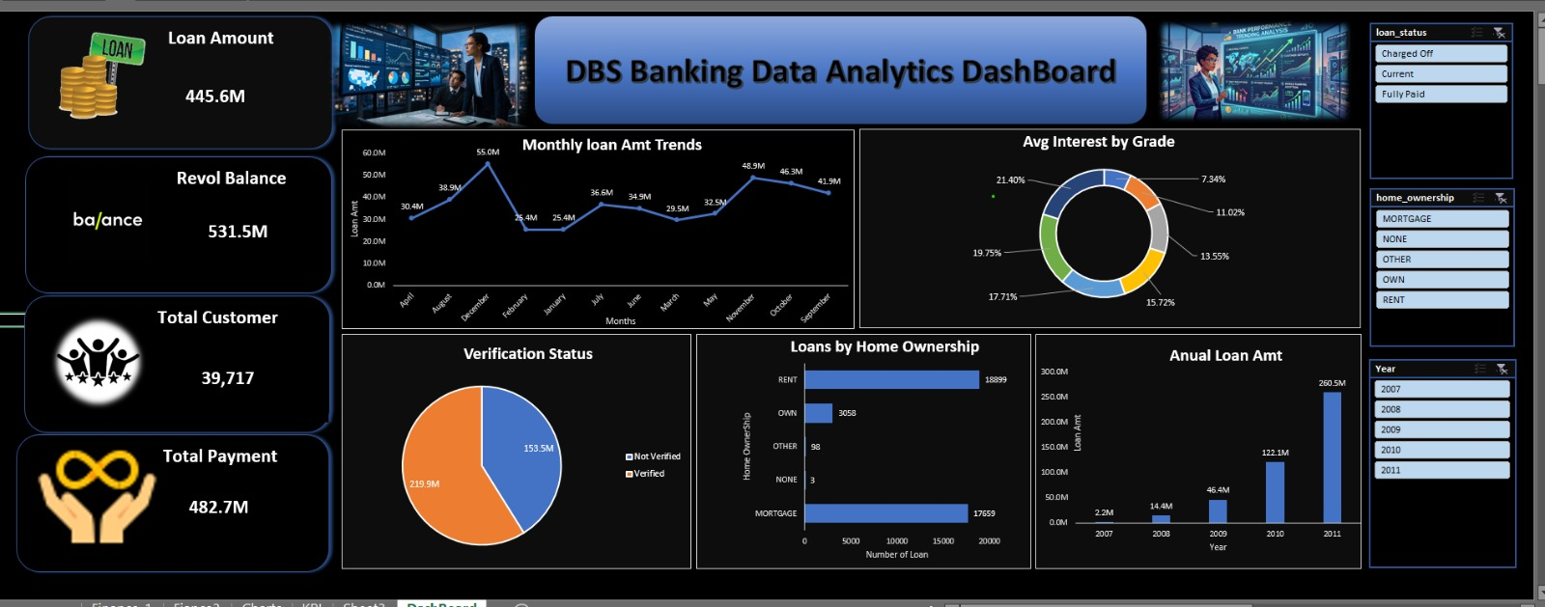
EXCEL DASHBOARD
Overview & KPIs
Built with PivotTables and slicers for loan status, home ownership and year — giving reviewers instant, filterable KPI views.
445.6M
531.5M
Loan Amount
Revol. Balance
39,717
482.7M
Total Customers
Total Payment
EXCEL DASHBOARD
6

Slide 7
EXCEL DASHBOARD
Trends & Insights
Monthly loan volume peaked at 55.0M in December and dipped to 25.4M in February and July
Verification is split almost evenly — 219.9M verified vs 153.5M not verified — a sizeable unverified exposure
MORTGAGE (17,659) and RENT (18,899) borrowers dominate; OWN accounts for only 3,058
Interest rate exposure is heavily concentrated in a handful of grade bands, led by the top two slices at 21.4% and 19.75%
Annual Loan Amount ($M)
EXCEL DASHBOARD
7

Slide 8
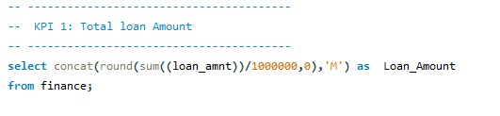
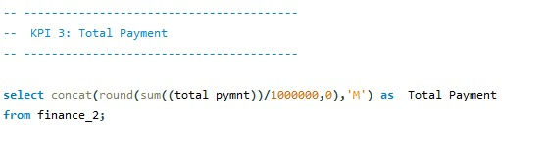
SQL QUERIES
KPI Calculations
Every headline number on the dashboards traces back to a validated SQL query.
KPI 1 — Total Loan Amount
KPI 3 — Total Payment
SUMs loan_amnt across the portfolio and scales it to millions for a clean, readable KPI.
Aggregates total_pymnt from the payments table, confirming the 482.7M figure shown on every dashboard.
SQL QUERIES
8

Slide 9
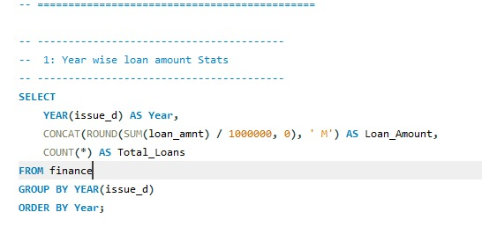
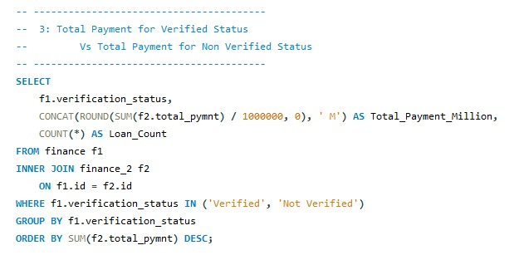
SQL QUERIES
Advanced Analysis
Year-Wise Loan Amount Stats
Verified vs Not Verified Payments
Groups originations by YEAR(issue_d), returning total loan amount and loan count per year to power the growth trend.
Joins the loan and payment tables on id, then compares total payments collected from Verified vs Not Verified borrowers.
SQL QUERIES
9

Slide 10
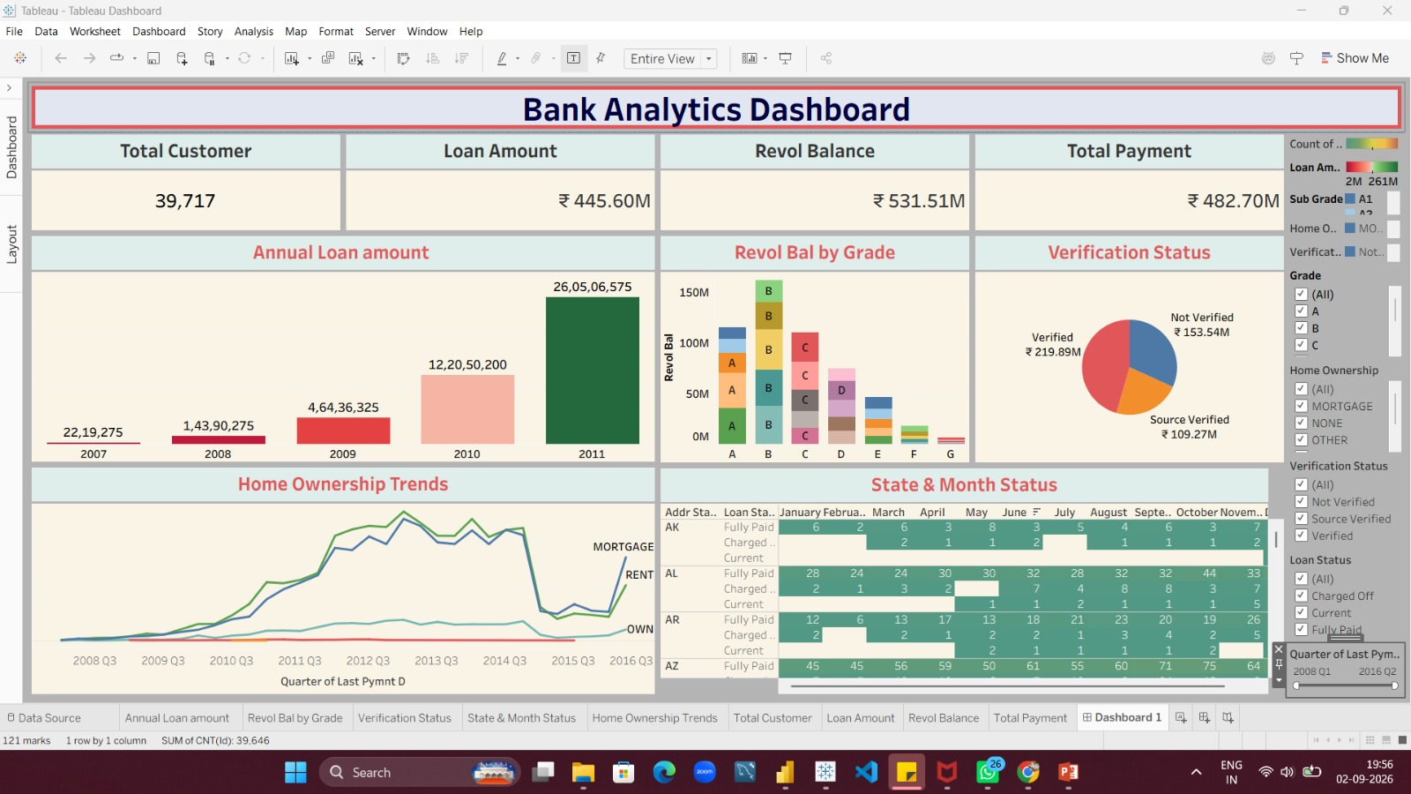
TABLEAU DASHBOARD
Overview & KPIs
A single Tableau workbook consolidates volume, balance, verification and geography into one filterable view.
39,717
Total Customers
₹445.60M
Loan Amount
₹482.70M
Total Payment
TABLEAU DASHBOARD
10

Slide 11
TABLEAU DASHBOARD
Visual Insights
Annual loan amount climbs from ₹22.2 lakh (2007) to ₹26.05 crore (2011) — confirming the growth trend seen in SQL and Excel
Revolving balance by grade shows Grade B carrying the largest concentration of outstanding balance
Verification split: ₹219.89M verified, ₹153.54M not verified, ₹109.27M source verified
Home-ownership trends (2008–2016) show MORTGAGE and RENT tracking closely, both far above OWN
State & month matrix breaks down Fully Paid / Charged Off / Current status by state and month for granular risk review
Verification Status ($M)
Total portfolio payments: ₹482.70M
TABLEAU DASHBOARD
11

Slide 12
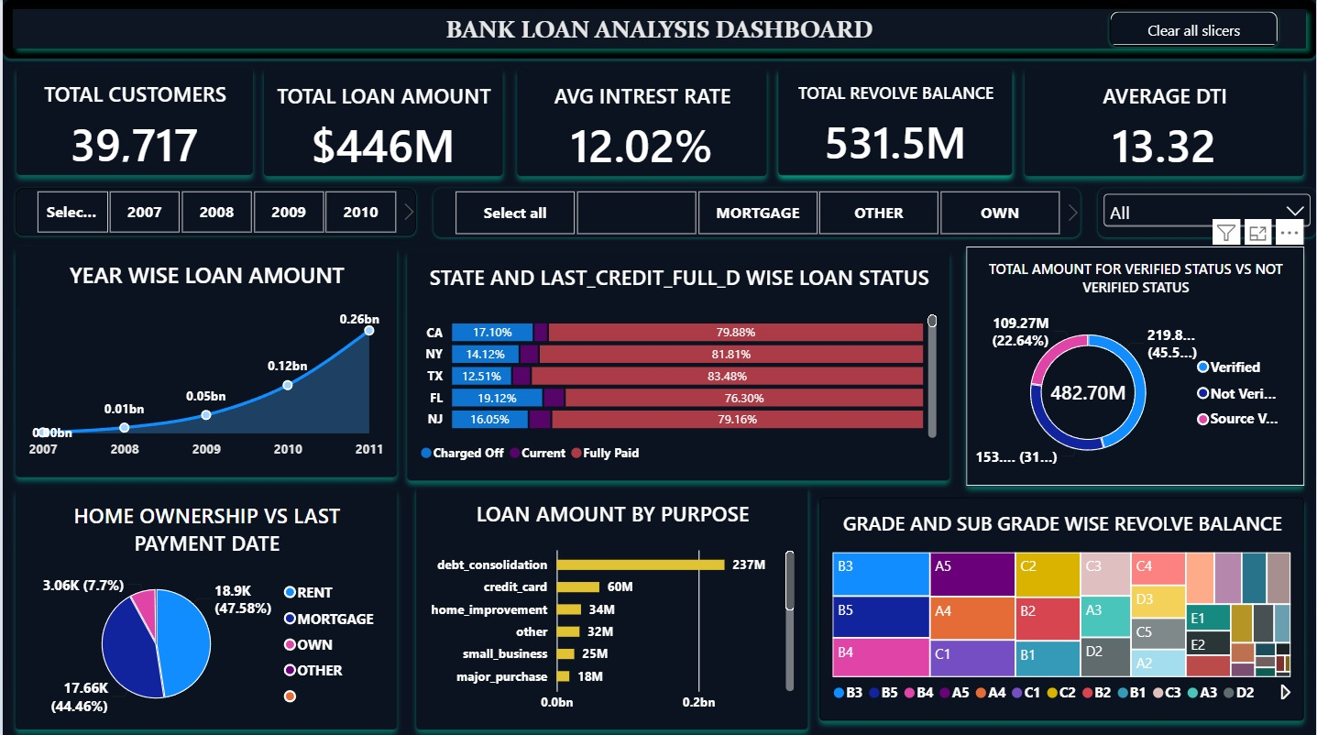
POWER BI DASHBOARD
Overview & KPIs
The Power BI report packages the same KPIs into a slicer-driven, executive-facing layout.
12.02%
13.32
Avg Interest
Average DTI
$446M
531.5M
Loan Amount
Revol. Balance
39,717
Total Customers
POWER BI DASHBOARD
12

Slide 13
POWER BI DASHBOARD
Visual Insights
Year-wise loan amount area chart shows steady, accelerating growth through 2011
CA, FL and NJ post the highest share of Current loans (76–84%), useful for state-level risk comparison
Debt consolidation leads loan purpose at $237M — more than 4x credit card, the next largest category ($60M)
Home ownership vs last payment date: RENT 47.6%, MORTGAGE 44.5%, OWN 7.7%
Grade & sub-grade treemap shows revolving balance concentrated in grades A–C, led by sub-grades B3–B5
Loan Amount by Purpose ($M)
POWER BI DASHBOARD
13

Slide 14
SYNTHESIS
Cross-Tool Comparison
Tool
Purpose
Strength
Best For
SQL
Validate & calculate every KPI
Precise, auditable logic
Confirming dashboard numbers
S
Excel
Fast, filterable KPI reporting
Familiar, slicer-driven
Day-to-day operational review
E
Tableau
Deep visual exploration
Rich, drillable charts
Analyst-level deep dives
T
Power BI
Enterprise BI reporting
Scalable & shareable
Executive presentations
P
SYNTHESIS
14

Slide 15
FINDINGS
Key Findings
118×
53%
Loan originations grew roughly 118-fold between 2007 and 2011, showing rapid portfolio scaling
Debt consolidation drives over half of total loan value — by far the dominant borrowing purpose
32%
92%
Share of the portfolio that is Not Verified — a meaningful risk-monitoring gap
Combined share of MORTGAGE and RENT borrowers, versus just 7.7% who own outright
FINDINGS
15

Slide 16
RECOMMENDATIONS
What We Recommend
1
Tighten Verification
2
Watch Concentration Risk
Prioritize closing the 150M+ Not-Verified gap through stronger income and identity checks at origination.
Monitor debt-consolidation exposure closely given its outsized, fast-growing share of the book.
3
Use Geography to Underwrite
4
Standardize on the SQL Layer
Apply state-level Current vs Charged-Off patterns (e.g. CA, FL, NJ) to refine underwriting by region.
Keep Excel, Tableau and Power BI KPI definitions locked to the validated SQL queries to prevent drift.
RECOMMENDATIONS
16

Slide 17
Thank You
Questions & Discussion
Bank Loan Analysis | SQL · Excel · Tableau · Power BI

